Slide 1
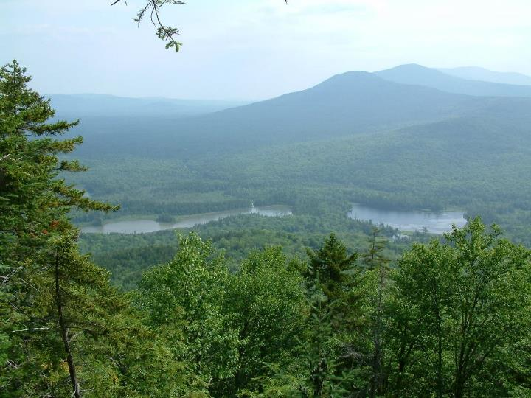
Watershed-scale conservation, restoration and management in the Maine Woods
Dr. David Publicover
Senior Staff Scientist
Appalachian Mountain Club
Gorham, NH

Slide 2
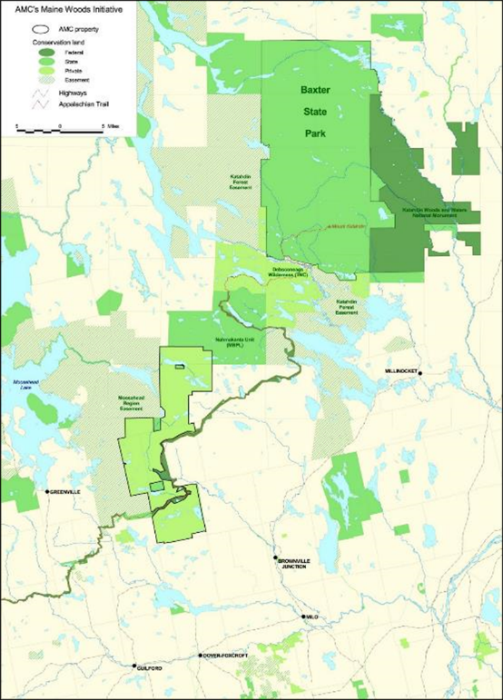
Notes:
AMC property encompasses ~70,000 acres acquired between 2003 and 2015.
Southern anchor of a fee-owned conservation corridor extending over 60 miles to northern end of Baxter State Park (nearly 500,000 acres in total).
Including easements, part of a contiguous conserved lands landscape of about 750,000 acres (nearly as large as WMNF).

Slide 3
Conservation

Slide 4
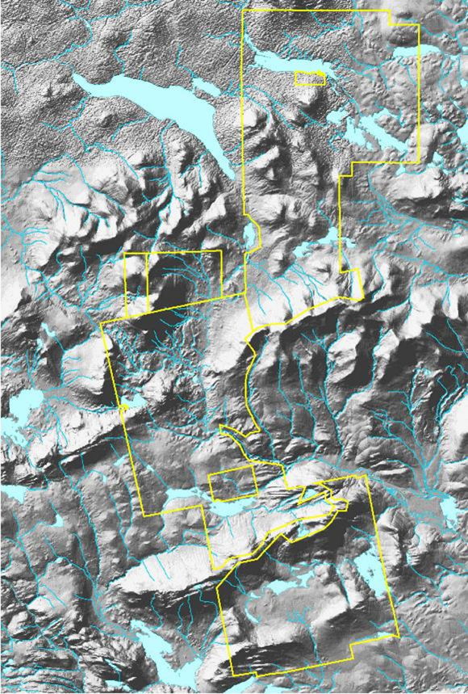

Slide 5
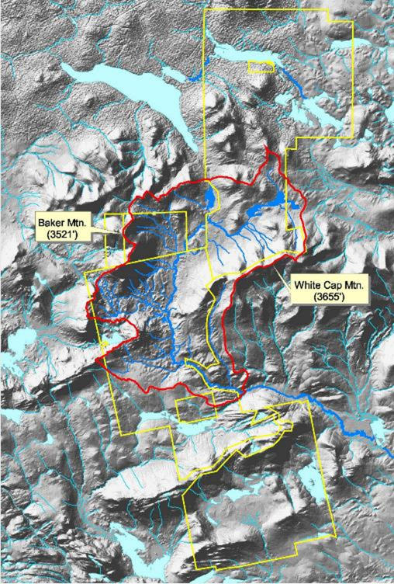
Upper West Branch Pleasant River
32,000 acre watershed.
Premier native brook trout fishery.
Bicknell's thrush habitat - upper elevations.
TNC portfolio priority freshwater ecosystem.
"An ecological treasure trove.“
"One of Maine's top ten undeveloped rivers."

Slide 6
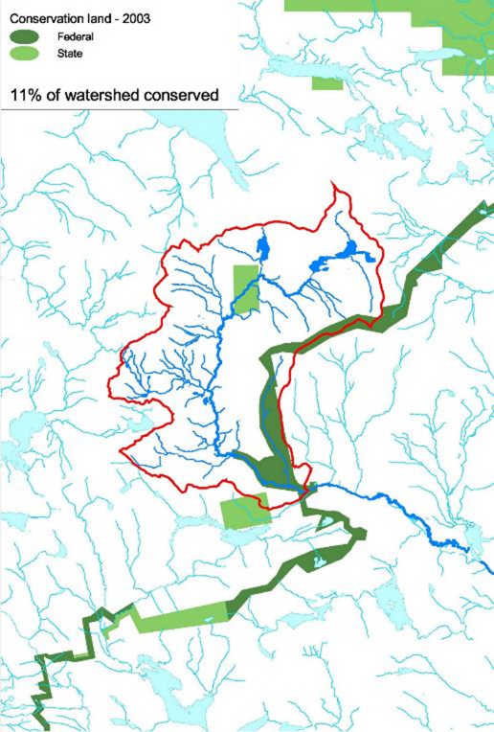

Slide 7
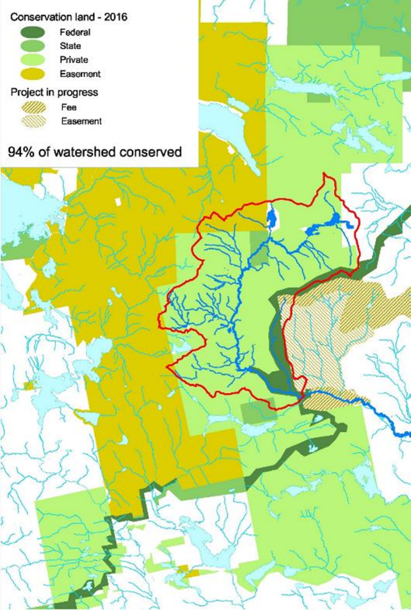

Slide 8
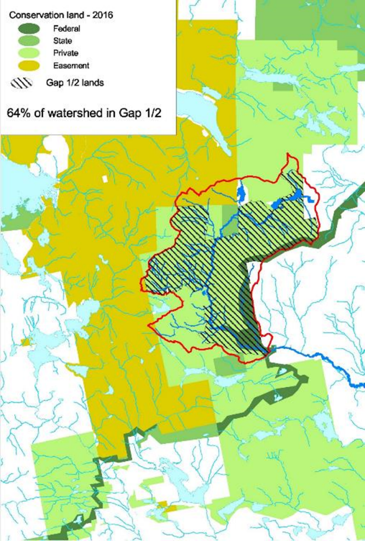

Slide 9
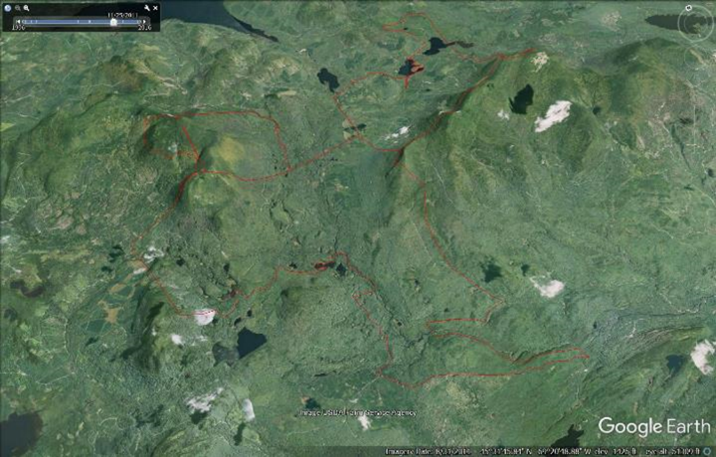

Slide 10
Restoration

Slide 11
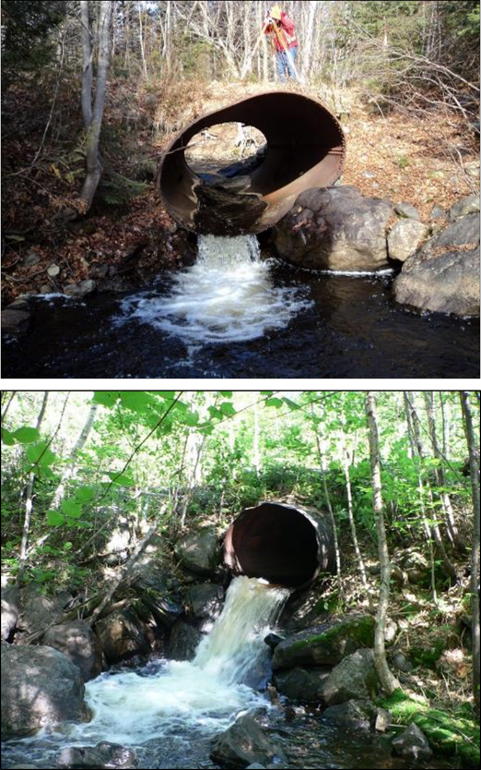

Slide 12
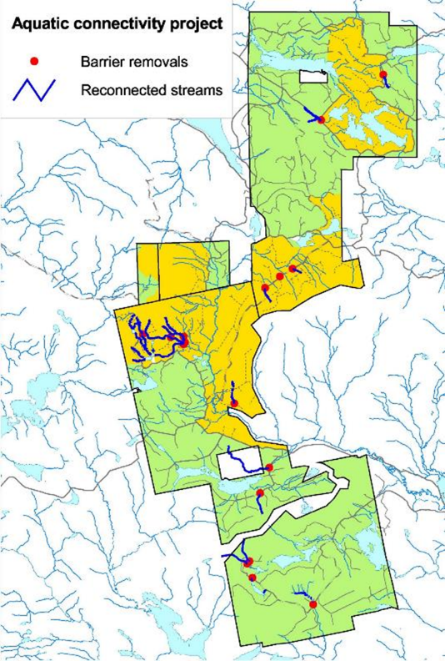
Notes:
19 Barriers removed; 22 miles of headwater stream reconnected.

Slide 13
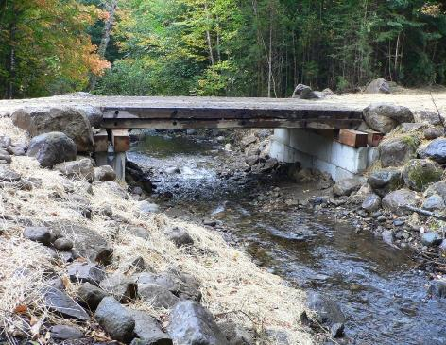
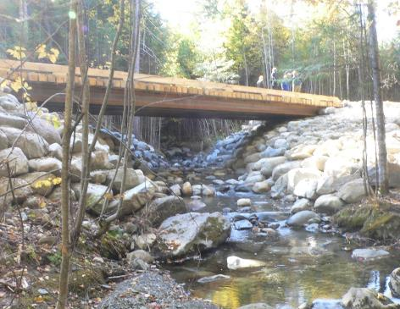

Slide 14
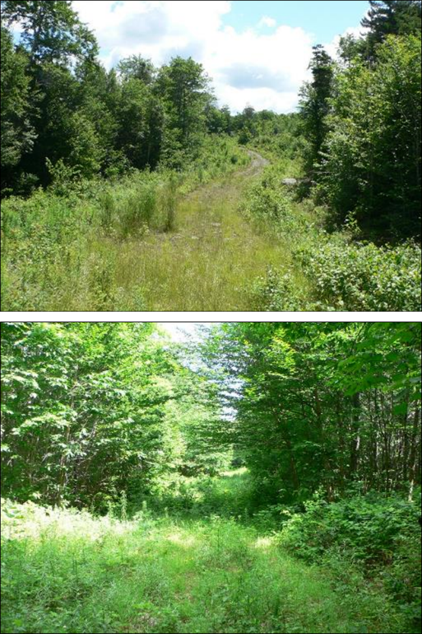

Slide 15
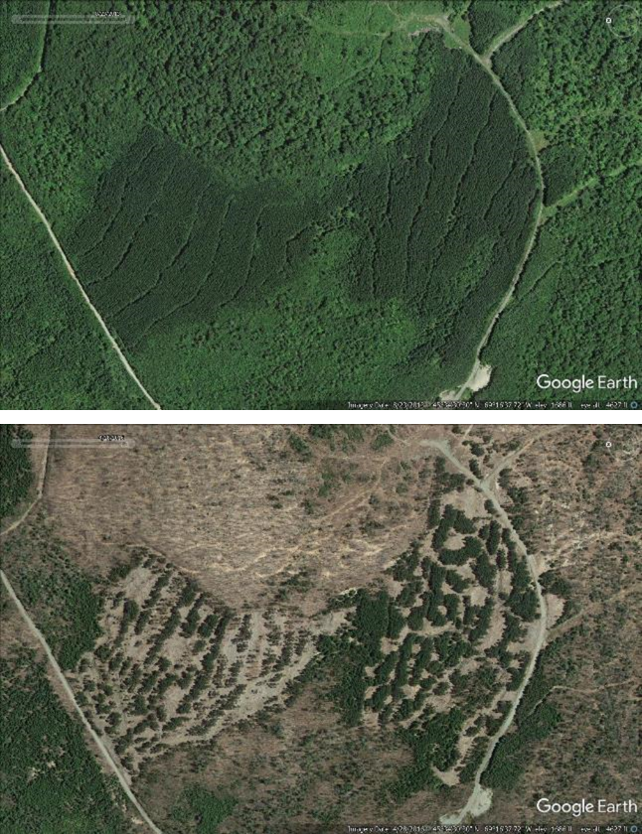
Roach Ponds Ecological Reserve – active management to restore unnatural plantation monocultures (red pine, black spruce).
50% removal of 62-acre red pine plantation in 2014.

Slide 16
Management

Slide 17
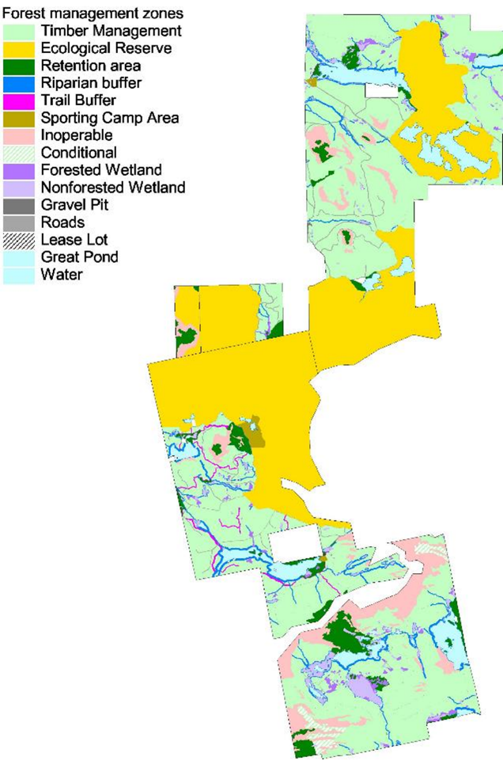

Slide 18
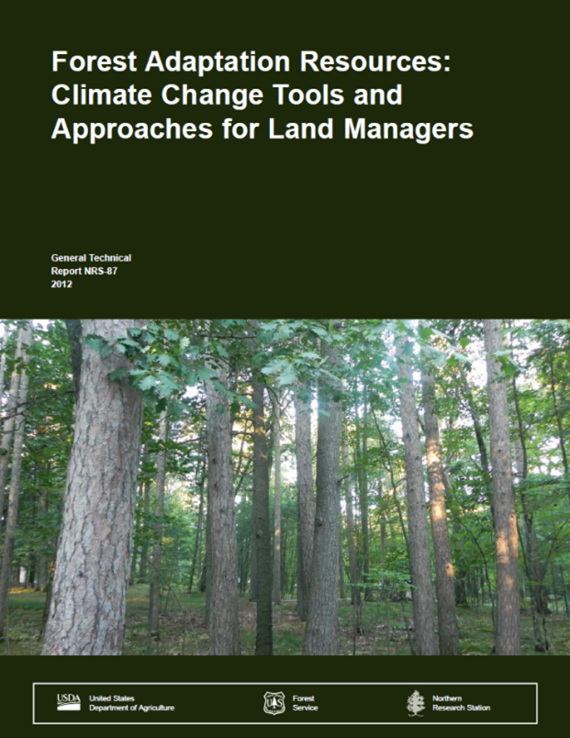

Slide 19
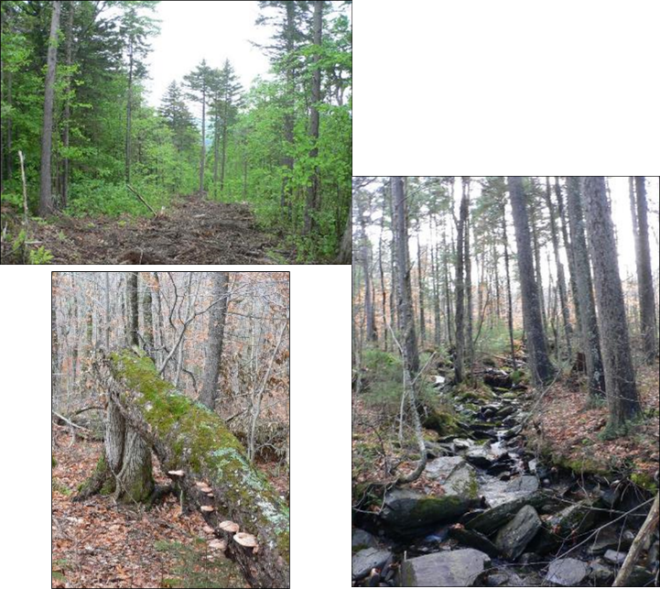
Strategy 1: Sustain fundamental ecological functions
Limit soil disturbance during harvesting (processor/forwarder system.
Retain and restore high levels of coarse woody debris.
Limit whole tree harvesting and biomass removals.
Restoration of stream habitat connectivity.
Upgrade road infrastructure and drainage structures.
No-harvest riparian zones.

Slide 20
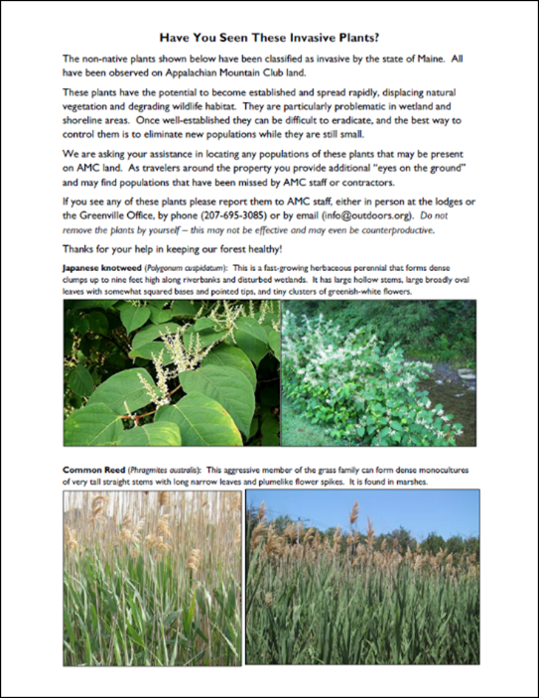
Strategy 2: Reduce the impact of existing biological stressors
Salvage diseased beech/retain “clean beech” (beech scale – Nectria complex).
Favor spruce over fir in thinnings (spruce budworm).
Maintain diverse species mix.
Invasive species monitoring program.

Slide 21
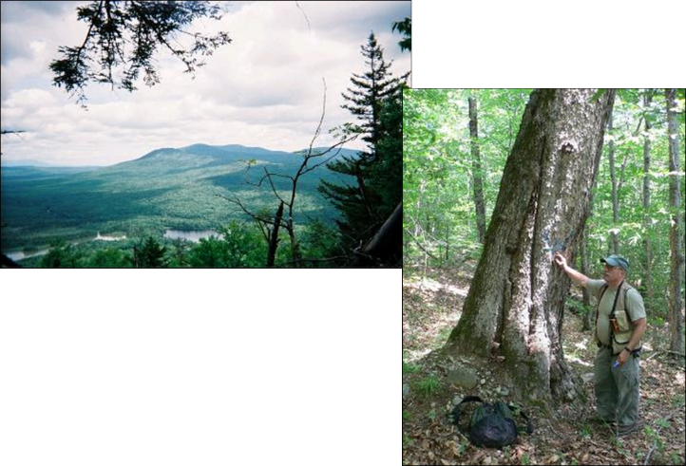
Strategy 3: Protect forests from severe fire and wind disturbance
Fire not a major issue.
Maintain multi-aged stand structures.
Retain vigorous trees/harvest at-risk trees.
Accept some level of natural disturbance as healthy.
Strategy 4: Maintain or create refugia
Establishment of large reserves.
Notably mature stands maintained as retention areas.
No harvesting in forested wetlands.
Refugia at multiple scales (fractal pattern) – watersheds within landscapes, stands within watersheds, trees within stands.

Slide 22
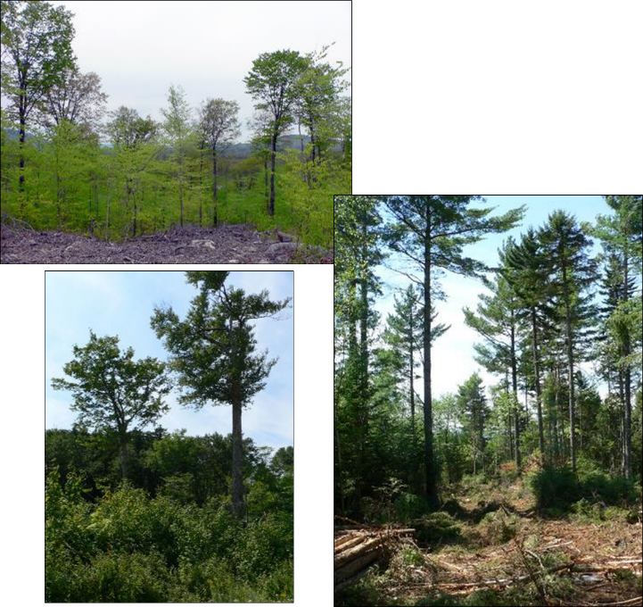
Strategy 5: Maintain and enhance species and structural diversity
Create and maintain multi-aged stands.
Maintain diverse species mix within stands.
Maintain and restore biological legacies/late-successional structures.
Remove and naturally regenerate off-site plantations (red pine, black spruce).
Retain white pine as climate adaptation seed source.

Slide 23
Strategy 6: Increase ecosystem redundancy across the landscape
Utilize natural regeneration.
Enhance softwood component on suitable soils.
Strategy 7: Promote landscape connectivity
Part of large contiguous conservation landscape (Moosehead Lake – 100 Mile Wilderness – Baxter State Park.
Restore aquatic habitat connectivity.
Participation in regional conservation partnerships (e.g. Maine Mountain Collaborative).
Strategy 8: Enhance genetic diversity
Not relevant – primarily deals with planting.
Strategy 9: Facilitate community adjustments through species transitions
Retain white pine as climate adaptation seed source.
Allow community adjustments through natural regeneration.
Strategy 10: Plan for and respond to disturbance
Spruce budworm risk assessment.
Targeted thinning of highest risk stands.

Slide 24
Monitoring

Slide 25
Monitoring on MWI properties
Limited monitoring of specific features or characteristics.
Periodic forest inventory (10-year cycle) and inventory of KIW Ecological Reserve carbon offset project (12-year cycle) will allow assessment of changes in forest composition and structure under active and passive management.
Annual monitoring by easement holders and FSC.
Participation in Maine Forest Service statewide spruce budworm monitoring.
Participation in AT Mega-Transect monitoring project.
Anticipated Bicknell’s thrush monitoring on Baker Mountain.
A plug for AMC monitoring activities in White Mountain National Forest!
Air quality (acidic deposition and ozone) since the 1980s.
Mapping of alpine plant communities for climate change baseline (also in Baxter State Park).
Mountain stream chemistry.
Alpine plant phenology.

